Slide 1

JSON and XML

Slide 2
Introduction to JSON
JSON (JavaScript Object Notation) is a lightweight data-interchange format.
Real-time server-to-browser communication.
It is easy for humans to read and write.
It is easy for machines to parse and generate.
JSON is a text format that is completely language independent.
These properties make JSON an ideal data-interchange language.
Notes:
how to obtain data from more than one table.

Slide 3
Introduction to JSON
JSON is built on two structures:
A collection of name/value pairs.
        In various languages, this is realized as an object, record, struct, dictionary, hash table, keyed list, or associative array.
An ordered list of values.
        In most languages, this is realized as an array, vector, list, or sequence.

Slide 4
Structure of JSON
An object is an unordered set of name/value pairs.
An object begins with
{ (left brace) and ends with } (right brace).
Each name is followed by : (colon) and the name/value pairs are separated by , (comma).
{"Company": “ABCD ", "Technologies": "C CPP Java Python", "Location": "Hyderabad"}

Slide 5
Reading and Writing JSON objects

Slide 6
JSON
To work with JSON, we should use Python's json module.
import json
Parse JSON in Python
      json module parses JSON strings and files containing JSON object.
      We can parse a JSON string using json.loads() method, returns a dictionary.
Notes:
how to obtain data from more than one table.

Slide 7
Converting JSON string into Python Dictionary object
import json
orgn = '{"Company": “ABCD ", "Technologies": ["GRE", "GMAT", "Campus Jobs"]}'
orgn_dict = json.loads(orgn)
print(orgn_dict)
print(orgn_dict['Company'])
print(orgn_dict['Technologies'])

Slide 8
Reading JSON object from file
Create a file named “orgn.json” in current working directory.
{ "Company": “ABCD",
"Technologies": [“C", “Java", “Python"] }
orgn.jason
Python program for reading Jason file
import json
with open('orgn.json') as f:
data = json.load(f)
print(data)

Slide 9
Converting Python dictionary to JSON object
import json
orgn_dict = {'Company’: ABCD ', 'Technologies': "C CPP Java Python", 'Location': 'Hyderabad'}
ogn_json = json.dumps(orgn_dict)
print(ogn_json)
Python Dictionary
JSON String object

Slide 10
dump()
The json library exposes the dump() method for writing data to files.
dump() takes two positional arguments:
(1) the data object to be serialized, and
(2) the file-like object to which the bytes will be written.

Slide 11
Writing JSON to a file
import json
orgn_dict = orgn_dict = {
'Name’: ABCD Tech',
'Location': "Hyderabad",
'Area' : 'Edu Tech Platform'
}
with open('orgn.txt', 'w') as json_file:
json.dump(orgn_dict, json_file)
JSON object
Writing to file
orgn.txt

Slide 12
Serialization and Deserialization
Dr Raju

Slide 13
Serialization and Deserialization
The process of encoding JSON is usually called serialization.
      i.e. transformation of data into a series of bytes (hence serial) to be stored or transmitted across a network.
Naturally, deserialization is the reciprocal process of decoding data that has been stored or delivered in the JSON standard.
Serializing JSON: the json library exposes the dump() method for writing data to files.
Desrialization JSON: In the json library load() and loads() for turning JSON encoded data into Python objects.

Slide 14
Python objects and their equivalent conversion to JSON
Python objects are translated to JSON according to an intuitive conversion.
Python | JSON
dict | object
list, tuple | array
str | string
int, long, float | number
True | true
False | false
None | null
JSON | Python
object | dict
array | list
string | str
number (int) | int
number (real) | float
true | True
false | False
null | None
Notes:
how to obtain data from more than one table.

Slide 15
dumps()
To analyze and debug JSON data, we may need to print it in a more readable format.
This can be done by passing additional parameters indent and sort_keys to json.dumps() and json.dump() method.
The default value of indent is None. And, the default value of sort_keys is False.
import json
orgn_str = '{"Company": “ABCD ", "Technologies": "C, CPP, Java, Python", "location": "Hyderabad"}'
orgn_dict = json.loads(orgn_str)
print(json.dumps(orgn_dict, indent = 8, sort_keys=True))

Slide 16
Reading web using JSON data

Slide 17
Reading JSON data from web
Try to implement an example how to read JSON data from live web site and store in a file Locally.
To download data from web, we need to take the help of requests module of Python.
Web link is : https://jsonplaceholder.typicode.com/todos
The requests module allows you to send HTTP requests using Python.
We can capture the return value of get(), which is an instance of Response, and stored it in a variable called response.
Exanple : response = requests.get("https://jsonplaceholder.typicode.com/todos")

Slide 18
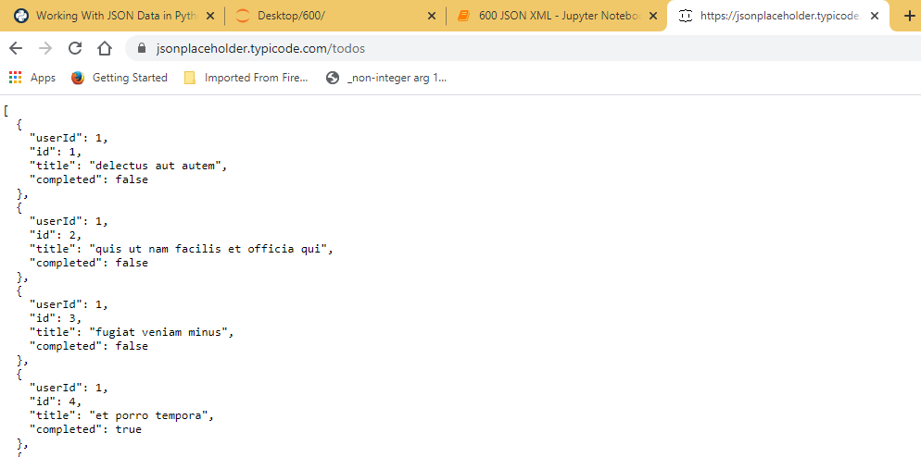
Structure of the data by visiting the endpoint in a browser
{
"userId": 1,
"id": 1,
"title": "delectus aut autem",
"completed": false
}

Slide 19
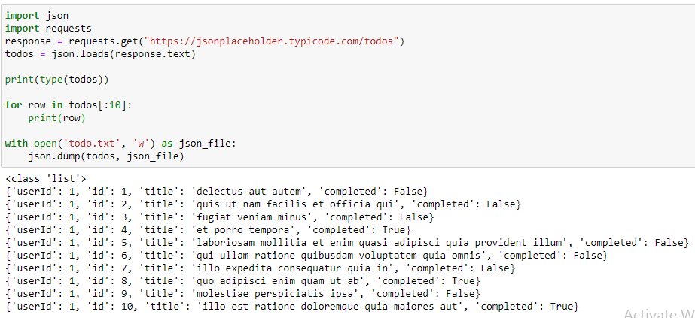
Implementation
import json
import requests
response = requests.get("https://jsonplaceholder.typicode.com/todos")
todos = json.loads(response.text)
print(type(todos))
for row in todos[:10]:
print(row)
with open('todo.txt', 'w') as json_file:
json.dump(todos, json_file)

Slide 20
Introduction to XML
Dr Raju

Slide 21
Introduction to XML
XML stands for Extensible Markup Language.
XML was designed to describe data.
We must define your own tags.
XML is much more difficult to parse than JSON.
XML docs are interoperable or language-independent.
An XML document contains wide variety of data.
<DEPTS>
<DEPT type = “Core”>
<DEPTNO>101</DEPTNO>
<DNAME>IT</DNAME>
</DEPT>
<DEPT type = “Core”> >
<DEPTNO>102</DEPTNO>
<DNAME>CSE</DNAME>
</DEPT>
</DEPTS>

Slide 22
Rules for XML
All XML elements must have a closing tag
XML tags are case sensitive
All XML elements must be properly nested
All XML documents must have a root element
Attribute values must always be quoted
<DEPTS>
<DEPT type = “Core”>
<DEPTNO>101</DEPTNO>
<DNAME>IT</DNAME>
</DEPT>
<DEPT type = “Core”> >
<DEPTNO>102</DEPTNO>
<DNAME>CSE</DNAME>
</DEPT>
</DEPTS>

Slide 23
What is a Parser?
Is a tool which load, parse (validate) and process (understands XML document structure) XML documents
Depends on the parser events may be fired or object given to the developer to process on his/her own.
Lifecycle of a Parser
Loading:
Parsing
Processing

Slide 24
Lifecycle of XML parser
i) Loading: Irrespective of the XML form (file/string/byte[]/url) the document must be I/Ped into parser as a stream of bytes
ii) Parsing:
a) Well-formed verification (Rules for XML)
b) Validation (optional)
      -XML structure can be defined in two ways:
      i) DTD (define simple doc structures) - Document Type Definition
      ii) Schema (set of rules) - define complex structure definitions
      The process of verifying XML document structure compared with structured defined in DTD/Schema

Slide 25
Lifecycle of XML parser
iii) Process:
There are two types parsers available:
a) SAX (Simple API for XML Parsing)
      First released parser
      Functionality limited to read only
      Event driven parser (fires event for each node on our application)
      Fastest
      Developer cannot hold control over on parsing
b) DOM (Document Object Model)
      Released next to SAX
      Functionality supports all DML operations
      Object Tree based (XML parser understands the document structure and prepares collection of objects called as collection of Nodes - NodeList)
      Slow
      Developer is having every control over on XML document

Slide 26
xml.etree.ElementTree module for Python
The xml.etree.ElementTree module implements API for parsing and creating XML data.
XML is an inherently hierarchical data format, represents as tree type.
ET has two classes for this purpose –
      ElementTree represents the whole XML document as a tree, and
      Element represents a single node in this tree.
  fromstring() parses XML from a string directly into an Element, which is the root element of the parsed tree.
  Element.find() finds the first child with a particular tag, and
  Element.text accesses the element’s text content.
  Element.get() accesses the element’s attributes.

Slide 27
Working with Python XML
Dr Raju

Slide 28
Accessing XML data -1
import xml.etree.ElementTree as ET
data = '''
<Company>
<name>ABCD</name>
<type>Online Platform</type>
<email id= "support@naresh.com" mobile = “1234-567890"/>
</Company>'''
tree = ET.fromstring(data)
print('Name:', tree.find('name').text)
print('Type:', tree.find('type').text)
print('EMail:', tree.find('email').get('id'))
print('Mobile:', tree.find('email').get('mobile'))

Slide 29
Accessing XML data -2
import xml.etree.ElementTree as ET
input = '''
<student>
<user x='1'>
<id>007</id>
<name>Virat</name>
</user>
<user x='2'>
<id>010</id>
<name>Rohith</name>
</user>
</student>''
student = ET.fromstring(input)
lst = student.findall('user')
print(len(lst))
for item in lst:
print('Name : ', item.find('name').text)
print('ID :',item.find('id').text)
print('Record:',item.get("x"))
print()
Name : Virat
ID : 007
Record: 1
Name : Rohith
ID : 010
Record: 2

